Slide 1


Doppio Breaking the Browser Language Barrier
Emery Berger and John Vilk

Slide 2

I
JS ?
CoffeeScript Related
CoffeeScript
CoffeeScript II: The Wrath of Khan
Coco
LiveScript
IcedCoffeeScript
Parsec CoffeeScript
Contracts.coffee
Uberscript
ToffeeScript
Caffeine
heap.coffee
EmberScript
Kaffeine
Jack
move
Moescript
pogoscript
LispyScript
Wisp
Hot Cocoa Lisp
Sibilant
Ham
GorillaScript
RedScript
Daonode
LiteScript
PyScript
Security enforcing JavaScript
Caja
ADsafe
FBJS
Jacaranda
Microsoft Web Sandbox
Gatekeeper
Dojo Secure
Local.js
Statically-typed JavaScript
Dart2JS
TypeScript
TeJaS
JavaScript++
MileScript
Mascara
Roy
Elm
JSX
Este.js
Swym
Typecast.js
purescript
JavaScript Language Extensions
ContextJS
Objective-J
Mochiscript
jangaroo
Flapjax
jLang
Restrict Mode
TIScript
Six
js--
Ruby
Opal
HotRuby
ColdRuby
rb2js
RubyJS
Red
Quby
8ball
Python
PYXC-PJ
Pyjamas
Pyjaco
Pyjs
Skulpt
PyCow
PyvaScript
RapydScript
Brython
PythonScript
pythonscript
PythonJS
Erlang
LuvvieScript
Perl
Perlito
Java/JVM
GWT
Java2Script
j2js
Strongly-Typed JavaScript (STJS)
BicaJVM
Processing
Kotlin
Ceylon
GrooScript
node-jvm
Bck2Brwsr
QWT
Scala
Scala.js
js-scala
scalagwt
JScala
C#, F#, .NET related languages
jsc
JSIL
Script#
Prefix
Blade
SharpKit
Saltarelle
FunScript
Pit
WebSharper
NemerleWeb
Blue Storm
JScriptSuite
DotNetWebToolkit
Lisp, Scheme
BiwaScheme
ClojureScript
clojurejs
Chlorinejs
wisp
EdgeLisp
Fargo
Moby Scheme
nconc
Parenscript
Ralph
scheme2js
Scriptjure
Spock
Whalesong
Oppo
Outlet
OCaml
Ocamljs
O'Browser
Js_of_ocaml
Haskell
UHC
ghcjs
jmacro
lambdascript
YHC
jshaskell
haste
fay
forml
Smalltalk
Amber
Clamato
Silver Smalltalk
Lively Kernel
Little Smallscript
C/C++
Emscripten
Duetto
maja
Clue
LLJS
Mandreel
Basic
NS Basic/App Studio
qb.js
Pascal
Smart Mobile Studio
Elevate Web Builder
Go
Go2js
GopherJS
TARDISgo
Multitarget
Haxe
Fantom
LZX (Laszlo XML)
Nimrod
Monkey
Defrac
Visual programming tools
Waterbear
Snap
ScriptBlocks
Illumination
JsMaker
Meemoo
NoFlo
Blockly
Maeda Block
SQL
sql-parser
sqld3
PHP
phype
uniter
Others
Oia
Plaid
Quixe
Gnusto
Logo Interpreter
p2js
Reb2Static
RPN
jsForth
wForth
Agda
XLCC
SMLtoJs
lua.js
Brozula
Pygmy
browserl
ErlyJS
Topaz
NGN APL
CobolScript
Idris
dogescript
Wortel
JEnglish
Jotlin
Notes:
Many people love JavaScript. But it is clear from the many programming languages out there that compile to or run in JavaScript that it is not perfect.

Slide 3


Slide 4





Static Types
Alternate Syntax
Legacy Languages
(Java)
(C/C++/LLVM IR)
Notes:
Programmers want to use these other languages for a variety of reasons.
Some bring static typing to the web, others expose a more convenient alternative syntax for JavaScript, and some are even implementations of legacy languages in the browser.
(And yes, some of these examples belong in multiple categories.)
With all of these languages, it appears that non-JS languages are proliferating on the web.

Slide 5

Notes:
So, we’re done, right? Well, not quite.

Slide 6





Notes:
What if I wanted to take some off-the-shelf software and run it in the web?

Slide 7

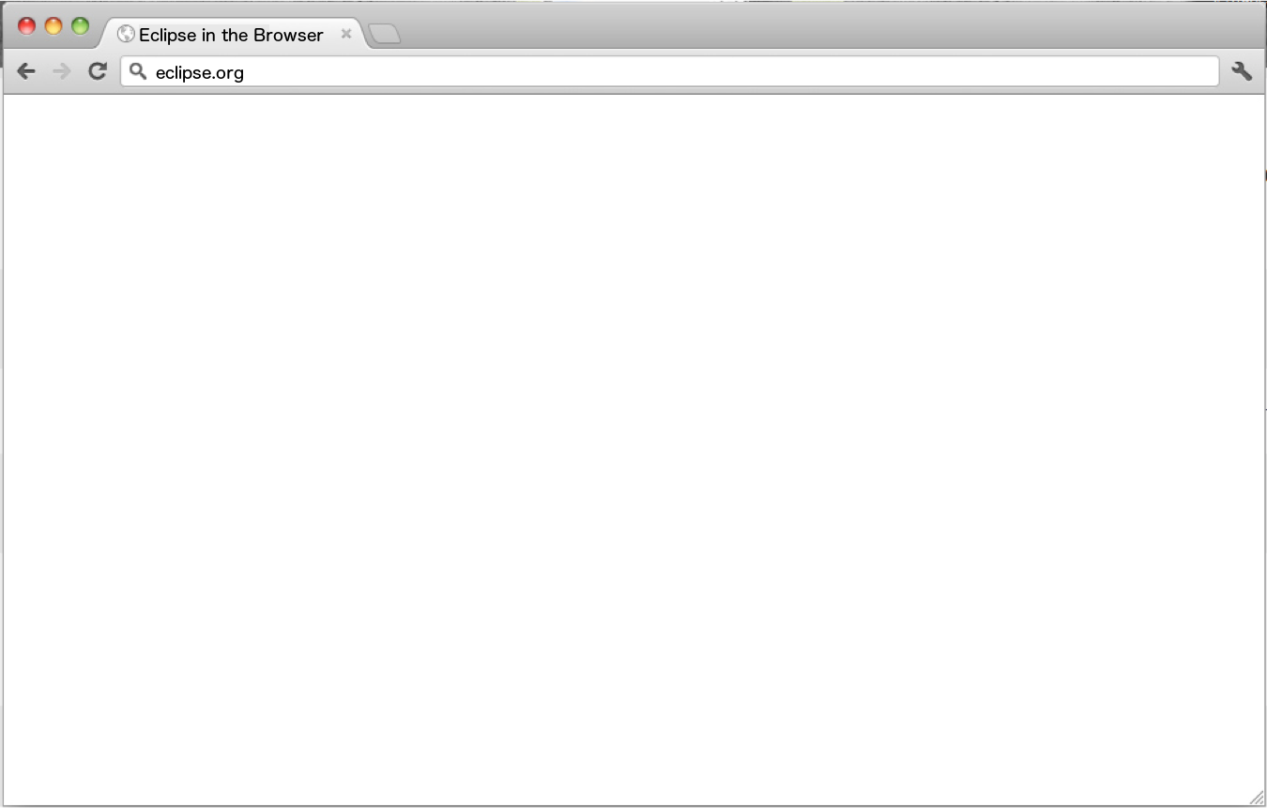
?
Notes:
Eclipse is written in Java; could I compile it to JavaScript using GWT?
Unfortunately, you cannot.

Slide 8

Native
Native
Browser
Notes:
What’s missing? Why can the native environment run Eclipse, but the web cannot?
The browser and native environments differ substantially in their execution environment and their services.
The native execution environment is multithreaded with support for context switches, allowing threads to transparently suspend and resume operations when blocked on a resource.
The browser execution environment, JavaScript, is an event-driven multiworker environment with run-to-completion events.
These differences prevent a direct translation of many languages to JavaScript.
For services, the operating system provides a host of handy abstractions, such as the file system, sockets, and dynamic memory allocation.
The browser provides somewhat comparable variants of these services, but as many of their APIs are non-blocking, the native operating system services cannot be directly emulated.
Both of these limitations must be addressed before off-the-shelf applications can run in the browser.
<hit space for fade>
But what if we could erase these differences… from the program’s perspective?
We present Doppio, a runtime system written entirely in TypeScript that addresses these differences, making it possible to run unmodified off-the-shelf software in the browser.
Doppio provides browser language implementations with the execution environment and the operating system abstractions that existing programs expect.
Using Doppio, we build DoppioJVM, a prototype Java Virtual Machine interpreter that can run unmodified JVM programs in the browser.

Slide 9

Native
Native
Browser
Multithreading
Context Switching
Notes:
What’s missing? Why can the native environment run Eclipse, but the web cannot?
The browser and native environments differ substantially in their execution environment and their services.
The native execution environment is multithreaded with support for context switches, allowing threads to transparently suspend and resume operations when blocked on a resource.
The browser execution environment, JavaScript, is an event-driven multiworker environment with run-to-completion events.
These differences prevent a direct translation of many languages to JavaScript.
For services, the operating system provides a host of handy abstractions, such as the file system, sockets, and dynamic memory allocation.
The browser provides somewhat comparable variants of these services, but as many of their APIs are non-blocking, the native operating system services cannot be directly emulated.
Both of these limitations must be addressed before off-the-shelf applications can run in the browser.
<hit space for fade>
But what if we could erase these differences… from the program’s perspective?
We present Doppio, a runtime system written entirely in TypeScript that addresses these differences, making it possible to run unmodified off-the-shelf software in the browser.
Doppio provides browser language implementations with the execution environment and the operating system abstractions that existing programs expect.
Using Doppio, we build DoppioJVM, a prototype Java Virtual Machine interpreter that can run unmodified JVM programs in the browser.

Slide 10

Native
Native
Browser
Multithreading
Context Switching
Multiworker
Run-to-completion
Notes:
What’s missing? Why can the native environment run Eclipse, but the web cannot?
The browser and native environments differ substantially in their execution environment and their services.
The native execution environment is multithreaded with support for context switches, allowing threads to transparently suspend and resume operations when blocked on a resource.
The browser execution environment, JavaScript, is an event-driven multiworker environment with run-to-completion events.
These differences prevent a direct translation of many languages to JavaScript.
For services, the operating system provides a host of handy abstractions, such as the file system, sockets, and dynamic memory allocation.
The browser provides somewhat comparable variants of these services, but as many of their APIs are non-blocking, the native operating system services cannot be directly emulated.
Both of these limitations must be addressed before off-the-shelf applications can run in the browser.
<hit space for fade>
But what if we could erase these differences… from the program’s perspective?
We present Doppio, a runtime system written entirely in TypeScript that addresses these differences, making it possible to run unmodified off-the-shelf software in the browser.
Doppio provides browser language implementations with the execution environment and the operating system abstractions that existing programs expect.
Using Doppio, we build DoppioJVM, a prototype Java Virtual Machine interpreter that can run unmodified JVM programs in the browser.

Slide 11

Native
Native
Browser
Multithreading
Context Switching
Multiworker
Run-to-completion
File System
Sockets
Unmanaged Heap
Notes:
What’s missing? Why can the native environment run Eclipse, but the web cannot?
The browser and native environments differ substantially in their execution environment and their services.
The native execution environment is multithreaded with support for context switches, allowing threads to transparently suspend and resume operations when blocked on a resource.
The browser execution environment, JavaScript, is an event-driven multiworker environment with run-to-completion events.
These differences prevent a direct translation of many languages to JavaScript.
For services, the operating system provides a host of handy abstractions, such as the file system, sockets, and dynamic memory allocation.
The browser provides somewhat comparable variants of these services, but as many of their APIs are non-blocking, the native operating system services cannot be directly emulated.
Both of these limitations must be addressed before off-the-shelf applications can run in the browser.
<hit space for fade>
But what if we could erase these differences… from the program’s perspective?
We present Doppio, a runtime system written entirely in TypeScript that addresses these differences, making it possible to run unmodified off-the-shelf software in the browser.
Doppio provides browser language implementations with the execution environment and the operating system abstractions that existing programs expect.
Using Doppio, we build DoppioJVM, a prototype Java Virtual Machine interpreter that can run unmodified JVM programs in the browser.

Slide 12

Native
Native
Browser
Multithreading
Context Switching
Multiworker
Run-to-completion
File System
Sockets
Unmanaged Heap
IndexedDB et al.
WebSockets / Flash Sockets
ArrayBuffers
Notes:
What’s missing? Why can the native environment run Eclipse, but the web cannot?
The browser and native environments differ substantially in their execution environment and their services.
The native execution environment is multithreaded with support for context switches, allowing threads to transparently suspend and resume operations when blocked on a resource.
The browser execution environment, JavaScript, is an event-driven multiworker environment with run-to-completion events.
These differences prevent a direct translation of many languages to JavaScript.
For services, the operating system provides a host of handy abstractions, such as the file system, sockets, and dynamic memory allocation.
The browser provides somewhat comparable variants of these services, but as many of their APIs are non-blocking, the native operating system services cannot be directly emulated.
Both of these limitations must be addressed before off-the-shelf applications can run in the browser.
<hit space for fade>
But what if we could erase these differences… from the program’s perspective?
We present Doppio, a runtime system written entirely in TypeScript that addresses these differences, making it possible to run unmodified off-the-shelf software in the browser.
Doppio provides browser language implementations with the execution environment and the operating system abstractions that existing programs expect.
Using Doppio, we build DoppioJVM, a prototype Java Virtual Machine interpreter that can run unmodified JVM programs in the browser.

Slide 13

Native
Native
Browser
Multithreading
Context Switching
Multiworker
Run-to-completion
Doppio
DoppioJVM
File System
Sockets
Unmanaged Heap
IndexedDB et al.
WebSockets / Flash Sockets
ArrayBuffers
Notes:
What’s missing? Why can the native environment run Eclipse, but the web cannot?
The browser and native environments differ substantially in their execution environment and their services.
The native execution environment is multithreaded with support for context switches, allowing threads to transparently suspend and resume operations when blocked on a resource.
The browser execution environment, JavaScript, is an event-driven multiworker environment with run-to-completion events.
These differences prevent a direct translation of many languages to JavaScript.
For services, the operating system provides a host of handy abstractions, such as the file system, sockets, and dynamic memory allocation.
The browser provides somewhat comparable variants of these services, but as many of their APIs are non-blocking, the native operating system services cannot be directly emulated.
Both of these limitations must be addressed before off-the-shelf applications can run in the browser.
<hit space for fade>
But what if we could erase these differences… from the program’s perspective?
We present Doppio, a runtime system written entirely in TypeScript that addresses these differences, making it possible to run unmodified off-the-shelf software in the browser.
Doppio provides browser language implementations with the execution environment and the operating system abstractions that existing programs expect.
Using Doppio, we build DoppioJVM, a prototype Java Virtual Machine interpreter that can run unmodified JVM programs in the browser.

Slide 14
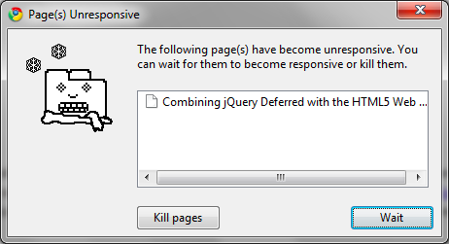
Notes:
Doppio provides an execution environment that provides an emulated thread pool, and a mechanism for suspending and resuming these emulated threads.
Language implementations execute within this environment, allowing them to interact with asynchronous, non-blocking JavaScript through blocking language interfaces.

Slide 15
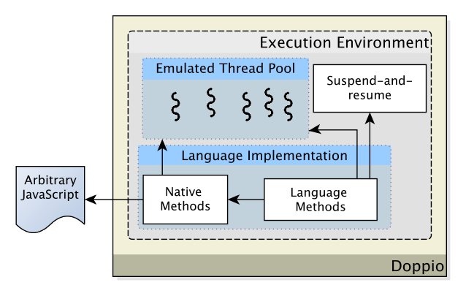
Doppio Execution Environment
Notes:
Doppio provides an execution environment that provides an emulated thread pool, and a mechanism for suspending and resuming these emulated threads.
Language implementations execute within this environment, allowing them to interact with asynchronous, non-blocking JavaScript through blocking language interfaces.

Slide 16
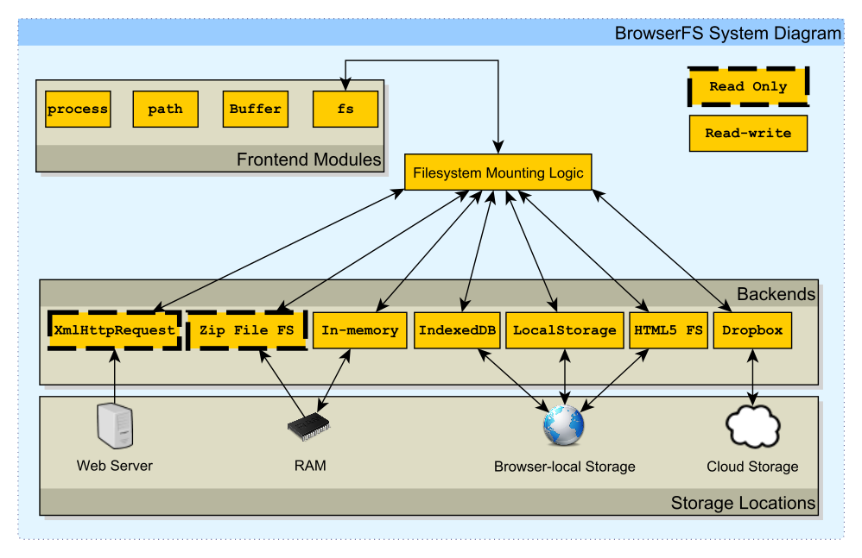
Doppio File System: BrowserFS
Notes:
Doppio provides a file system, which we dub ‘BrowserFS’.
BrowserFS unifies a wide variety of browser storage mechanisms under an emulation of the NodeJS file system API, which is itself a thin layer over native file system calls.

Slide 17
BrowserFS File System Abstraction
File System Backend Interface
rename
stat
open
unlink
rmdir
mkdir
readdir
close
sync
Notes:
For NFS-style sync-on-close semantics, a file system only needs to implement the following 9 methods.
This abstraction has allowed us to implement a wide variety of backends to the Doppio file system.

Slide 18
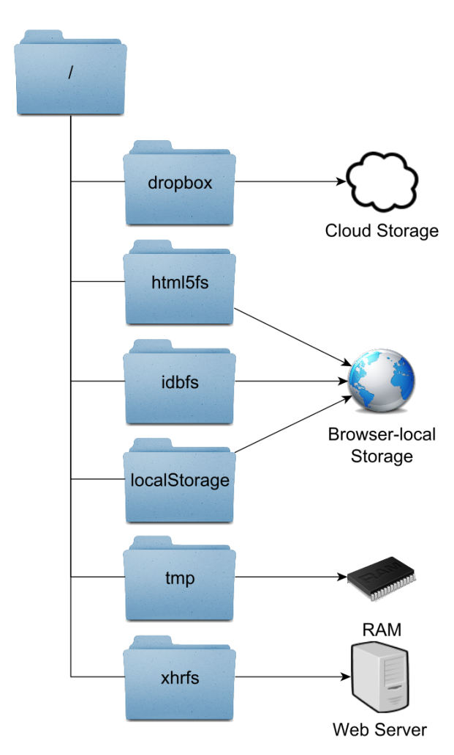
Mount All The Backends
Notes:
It does not take much code to prepare the file system.
In this example, we mount six separate file system backends in 13 lines of code.
Note that each backend has a convenient method to check if you can use it in the current browser; we omit those checks for brevity.

Slide 19
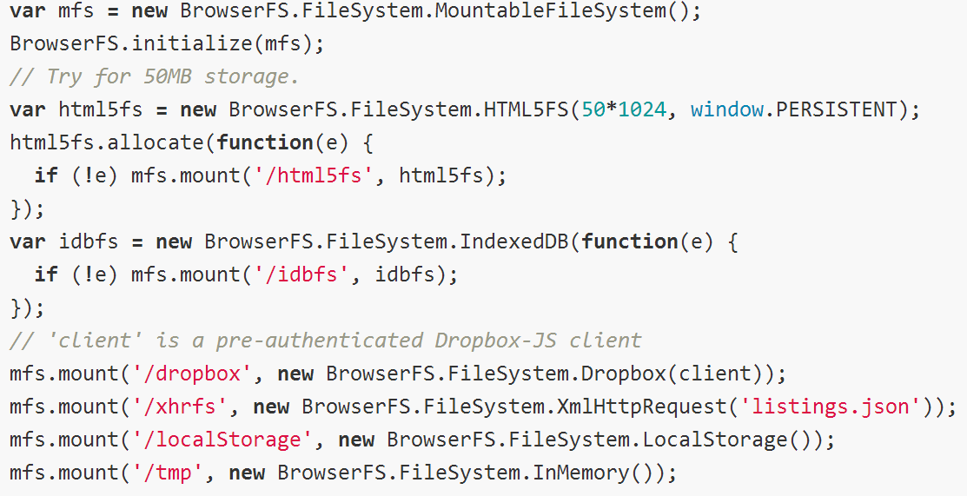
Mount All The Backends
Notes:
It does not take much code to prepare the file system.
In this example, we mount six separate file system backends in 13 lines of code.
Note that each backend has a convenient method to check if you can use it in the current browser; we omit those checks for brevity.

Slide 20
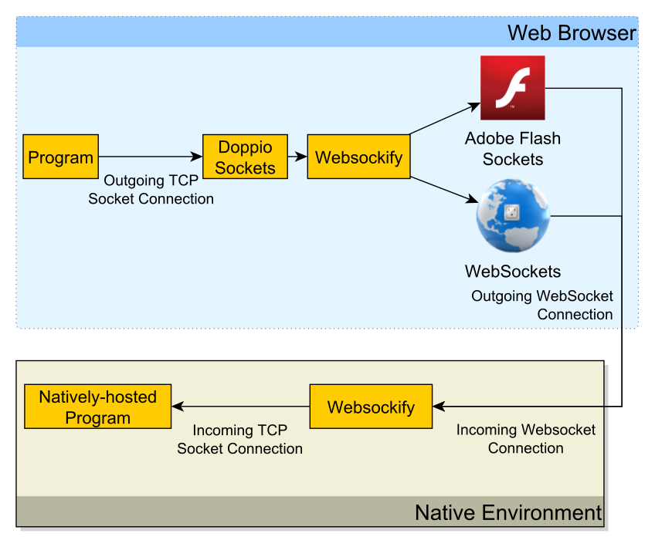
Doppio: TCP Sockets
Notes:
Doppio exposes a standard TCP socket API to language implementations on top of WebSockets, which are implemented in the latest version of every major browser.
While it is impossible to use WebSockets to make general-purpose binary TCP connections, it is possible to use software on either end to “bridge” the gap.
Doppio uses the Websockify library as this bridge. Websockify handles converting a binary stream of information into WebSocket messages (and vice versa) using JavaScript in the browser, and Python on the server.
Websockify also supports an implementation of WebSockets on top of Adobe Flash sockets, allowing Doppio Sockets to function in older browsers that lack WebSocket support.

Slide 21

Notes:
The Doppio “unmanaged” heap uses a conventional heap design. Languages can map their explicit allocation interfaces onto the Doppio heap. For example, DoppioJVM maps a portion of the Java Class Library’s ‘Unsafe’ API to the Doppio heap.
Up until the relatively recent introduction of Typed Arrays, representing binary data in the browser has been difficult. Doppio uses its emulation of NodeJS buffers as an abstraction layer for storing and reading binary data.
In browsers with support for typed arrays, it uses a typical ArrayBuffer.
In browsers with support for the HTML5 canvas but no support for typed arrays, it uses a CanvasPixelArray, which, prior to the introduction of Typed Arrays, backed canvas ImageData objects. It is the ancestor to the UInt8ClampedArray, which is the Typed Array that currently backs ImageData objects.
Finally, if it’s IE8– I mean, a browser that supports neither, it uses an array of 32-bit integers. As you may know, JavaScript numbers are actually doubles, so this may result in 2X memory overhead, depending on how the JavaScript engine represents them. While many people currently opt to use an array of 8-bit integers, this is space-inefficient, and slow for large reads or writes. Doppio brings the “fun” of aligned memory access optimizations to the browser.
(If anyone asks:
For the non-typed array representations, our Buffer implementation contains all of the logic required to reinterpret bytes of data as integers and floating point numbers of various sizes.
)
(If you want to show code for funs:
Int => float https://github.com/jvilk/BrowserFS/blob/master/src/core/buffer_core.ts#L400
2 32-bit ints => double https://github.com/jvilk/BrowserFS/blob/master/src/core/buffer_core.ts#L423
Double => 2 32-bit ints https://github.com/jvilk/BrowserFS/blob/master/src/core/buffer_core.ts#L349
Float => 32-bit int: https://github.com/jvilk/BrowserFS/blob/master/src/core/buffer_core.ts#L306
Binary data => UTF8: https://github.com/jvilk/BrowserFS/blob/master/src/core/string_util.ts#L109
)
(If anybody asks: We use Little Endian, just like the Web)

Slide 22
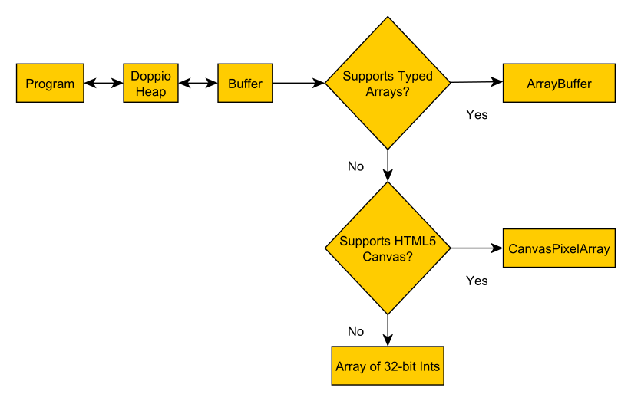
Doppio Unmanaged Heap
Notes:
The Doppio “unmanaged” heap uses a conventional heap design. Languages can map their explicit allocation interfaces onto the Doppio heap. For example, DoppioJVM maps a portion of the Java Class Library’s ‘Unsafe’ API to the Doppio heap.
Up until the relatively recent introduction of Typed Arrays, representing binary data in the browser has been difficult. Doppio uses its emulation of NodeJS buffers as an abstraction layer for storing and reading binary data.
In browsers with support for typed arrays, it uses a typical ArrayBuffer.
In browsers with support for the HTML5 canvas but no support for typed arrays, it uses a CanvasPixelArray, which, prior to the introduction of Typed Arrays, backed canvas ImageData objects. It is the ancestor to the UInt8ClampedArray, which is the Typed Array that currently backs ImageData objects.
Finally, if it’s IE8– I mean, a browser that supports neither, it uses an array of 32-bit integers. As you may know, JavaScript numbers are actually doubles, so this may result in 2X memory overhead, depending on how the JavaScript engine represents them. While many people currently opt to use an array of 8-bit integers, this is space-inefficient, and slow for large reads or writes. Doppio brings the “fun” of aligned memory access optimizations to the browser.
(If anyone asks:
For the non-typed array representations, our Buffer implementation contains all of the logic required to reinterpret bytes of data as integers and floating point numbers of various sizes.
)
(If you want to show code for funs:
Int => float https://github.com/jvilk/BrowserFS/blob/master/src/core/buffer_core.ts#L400
2 32-bit ints => double https://github.com/jvilk/BrowserFS/blob/master/src/core/buffer_core.ts#L423
Double => 2 32-bit ints https://github.com/jvilk/BrowserFS/blob/master/src/core/buffer_core.ts#L349
Float => 32-bit int: https://github.com/jvilk/BrowserFS/blob/master/src/core/buffer_core.ts#L306
Binary data => UTF8: https://github.com/jvilk/BrowserFS/blob/master/src/core/string_util.ts#L109
)
(If anybody asks: We use Little Endian, just like the Web)

Slide 23
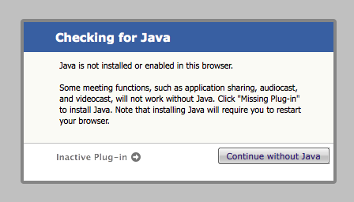

Slide 24
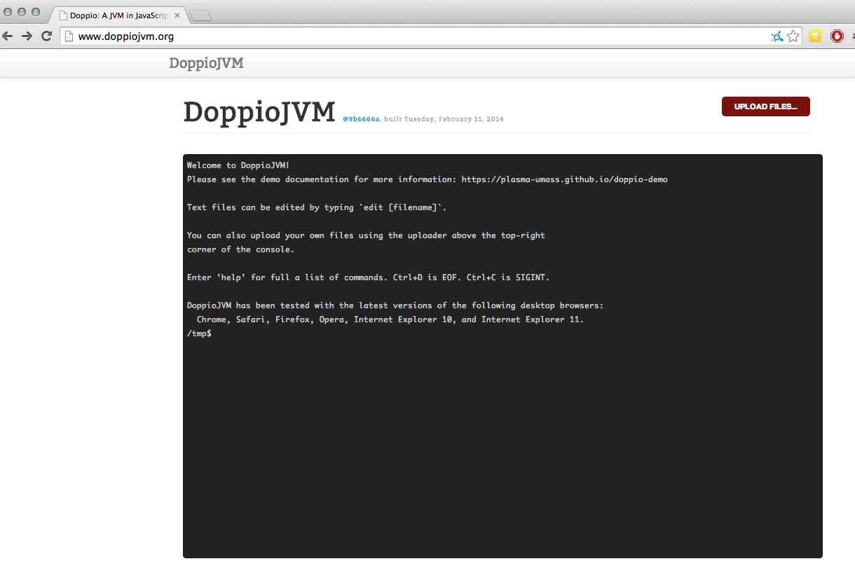
DoppioJVM: Look Ma, No Plugin
Notes:
JVM Interpreter in JavaScript, executes within Doppio’s execution environment and uses its OS abstractions.
Can run unmodified programs, etc.

Slide 25
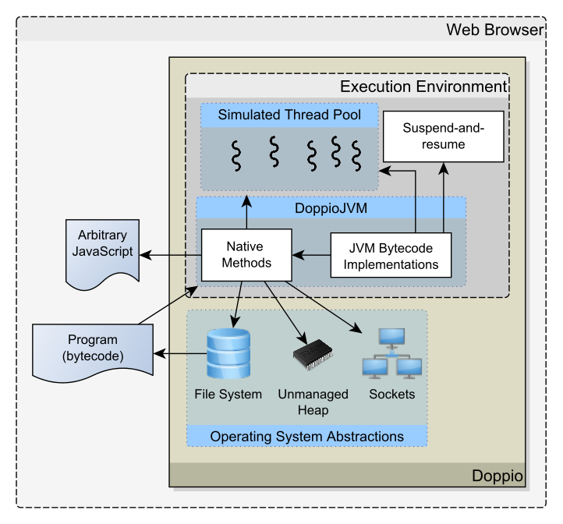
DoppioJVM: Look Ma, No Plugin
Notes:
JVM Interpreter in JavaScript, executes within Doppio’s execution environment and uses its OS abstractions.
Can run unmodified programs, etc.

Slide 26
DoppioJVM Performance
Compared against HotSpot Interpreter running natively Benchmarks:
javap (4 KLOC)
Disassemble class files comprising javac (491 files)
javac (44 KLOC)
Compile javap (19 source files)
Rhino (57 KLOC)
SunSpider recursive and binary-trees benchmarks
Kawa-Scheme (121 KLOC)
nqueens algorithm with input ‘8’
Notes:
Benchmarked DoppioJVM, compared it against HotSpot interpreter

Slide 27
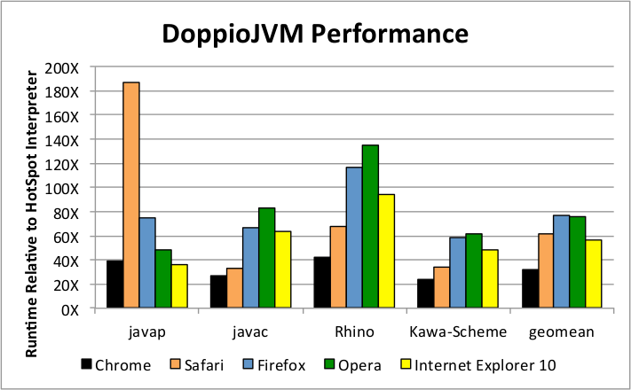
DoppioJVM Performance
*
* Caused by Safari memory leak: https://bugs.webkit.org/show_bug.cgi?id=119049
Notes:
DoppioJVM is untuned, etc.
DoppioJVM achieves its highest performance on Chrome: compared to the HotSpot interpreter, DoppioJVM runs between 24x and 42x (geometric mean: 32x)
The javap benchmark took abnormally long to complete in Safari. This was caused by a severe memory leak tied to Safari’s Typed Array implementation, which has since been fixed. The javap benchmark is the most file system intensive benchmark out of all of the

Slide 28
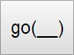
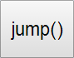
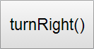

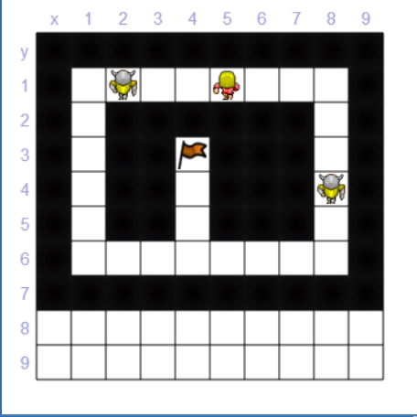
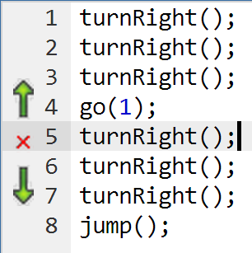

DoppioJVM CodeMoo.com
Notes:
DoppioJVM is currently used on the University of Illinois’ CodeMoo.com website, which teaches children basic programming skills through interactive games.
For example, in this game, children must string together the commands “go”, “jump”, and “turnRight” to lead their character to the goal without bumping into an enemy.
They click on the buttons to insert function calls into the program, and then click the green button to compile and run the program.
As you might expect, CodeMoo places these instructions into a Java file, uses Doppio to compile and run the program entirely in JavaScript.
The functions ‘turnRight’, ‘go’, etc. are blocking functions from the Java point of view, but are non-blocking in JavaScript. Each trigger a Doppio thread to suspend to context switch to the browser, which updates the display to animate the character.

Slide 29

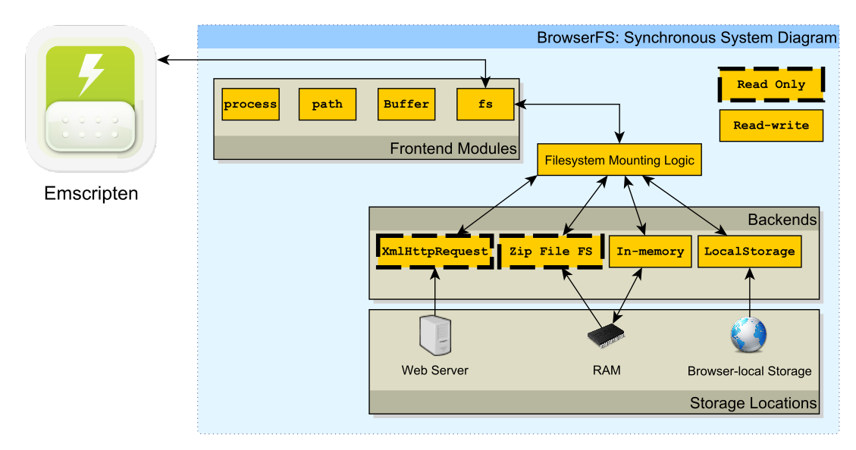
Doppio (BrowserFS) + Emscripten
Notes:
Emscripten doesn’t modify the execution environment.
Programs are modified to work around web’s limitations. Any blocking OS services must also be blocking in JavaScript, fundamentally limiting how Emscripten can emulate required native resources.
However, it can use Doppio’s synchronous operating system services.
In particular, we wrote a plugin for Emscripten’s file system, allowing Emscripten to make use of our synchronous file system backends: the ZipfileFS, XmlHttpRequest file system, the localStorage file system, and the in-memory file system.

Slide 30

Notes:
As a case study, we mounted the Doppio file system into Emscripten to enable the game ‘Me and My Shadow’, previously ported to Emscripten by Alon, to function without explicit file reloading, and to save game data to localStorage.
Prior to this, you would start up a game…

Slide 31
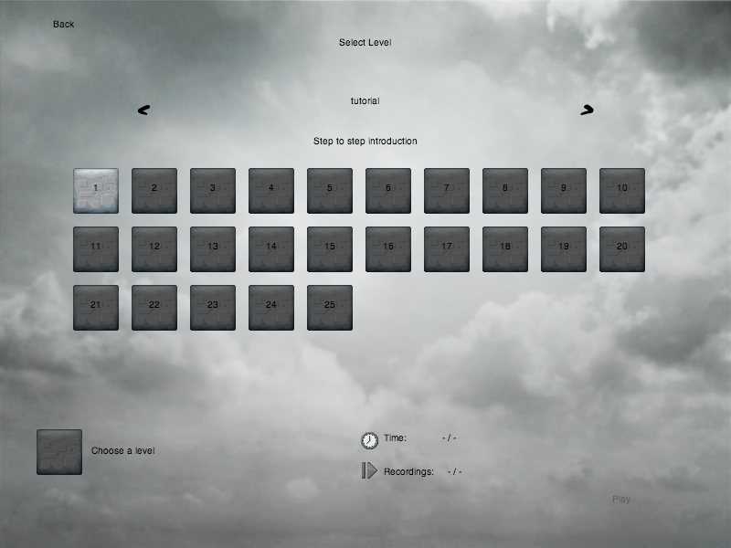
Notes:
Choose Level 1…

Slide 32

Notes:
Get a gold medal…

Slide 33
Notes:
Come back later… where’s the gold medal?! Didn’t save your progress in the file system, since it’s in-memory!

Slide 34
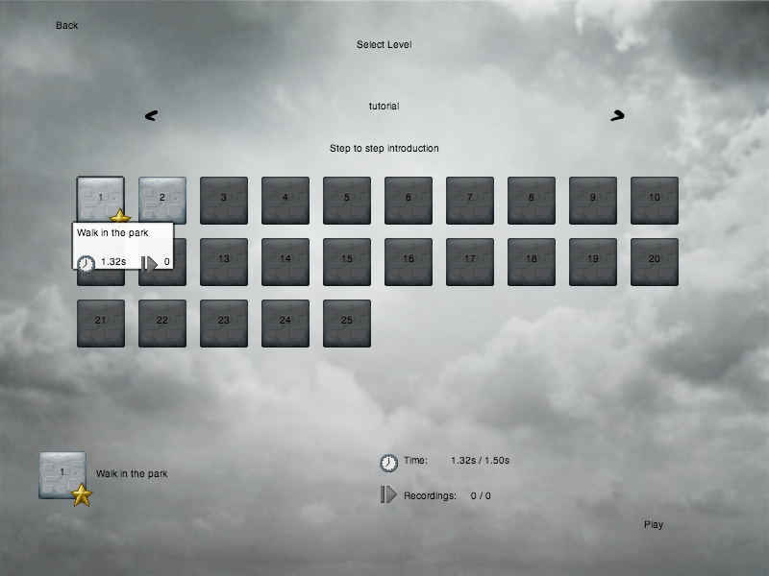
Notes:
With *NO* modifications to the game, the same game running in Emscripten on top of Doppio’s file system correctly recalls the medal I earned, as Doppio persisted it in browser-local storage.

Slide 35
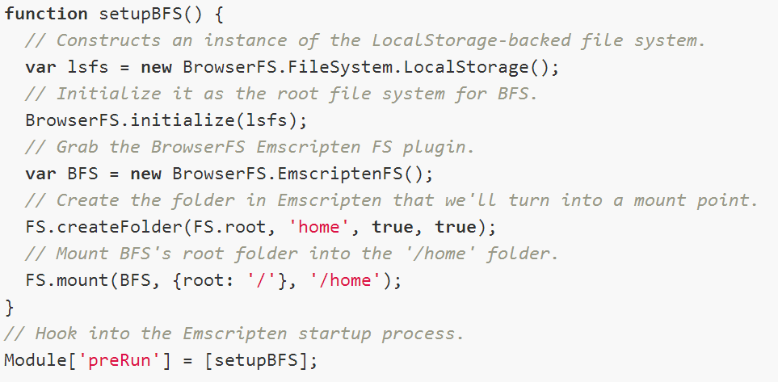
Doppio (BrowserFS) + Emscripten
Notes:
Emscripten doesn’t modify the execution environment.
Programs are modified to work around web’s limitations. Any blocking OS services must also be blocking in JavaScript, fundamentally limiting how Emscripten can emulate required native resources.
However, it can use Doppio’s synchronous operating system services.
In particular, we wrote a plugin for Emscripten’s file system, allowing Emscripten to make use of our synchronous file system backends: the ZipfileFS, XmlHttpRequest file system, and the localStorage file system.
For example, the code on this slide is all that is required to back a folder in the Emscripten file system with localStorage.

Slide 36
Future Work
BrowserFS:
Make data-intensive applications easier in browser (block-level access)
Dynamically adapt to device conditions, e.g:
Latency & bandwidth, memory limits
DoppioJVM:
Fine, fine, maybe a JIT

Slide 37
Future Work
BrowserFS:
Make data-intensive applications easier in browser (block-level access)
Dynamically adapt to device conditions, e.g:
Latency & bandwidth, memory limits
DoppioJVM:
Fine, fine, maybe a JIT

Slide 38
Future Work
BrowserFS:
Make data-intensive applications easier in browser (block-level access)
Dynamically adapt to device conditions, e.g:
Latency & bandwidth, memory limits
DoppioJVM:
Fine, fine, maybe a JIT

Slide 39

Doppio Breaking the Browser Language Barrier [PLDI 2014]
Check it out at
doppiojvm.org
Emery Berger and John Vilk

